Slide 1
Measuring mortality rates in Iraq:
Technologies for generating credible estimates of deaths caused by the 2003-2011 war and occupation
March 7, 2014
Abraham D. Flaxman
Assistant Professor

Slide 2
Outline
Introduction
Designing a controversial study
Results
Future directions

Slide 3
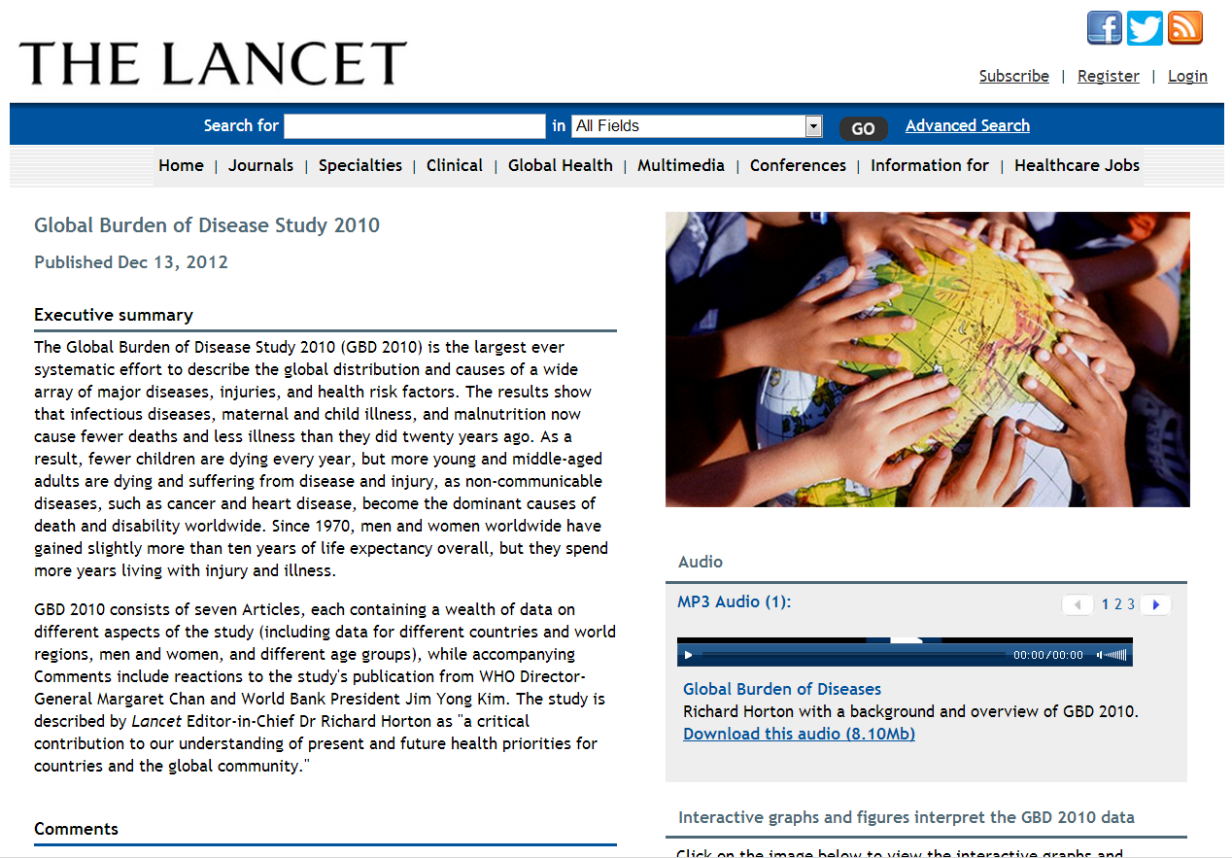
DALYs = YLL + YLD
Notes:
I’m an assistant professor of global health, but I used to be a mathematician. I started working on global health metrics for the Global Burden of Disease 2010 Study about five years ago.
The GBD 2010 is a massive, collaborative effort to quantify the burden of over 200 diseases, injuries, and risk factors, and make comparable estimates of how much health each condition claims geographically and temporally.
When I left math to work on disease burden estimation, my colleagues in the math department thought this change in direction was a little weird. At least unusual.
When I would tell them about what I’ve been doing, they often say “yeah, yeah, sounds great…” but when I did manage to interest them in it, the first question was often “What units?” What units did we use to quantify disease burden?”
The answer is “years”, or disability-adjusted life years, to be specific. This DALY is a summary health metric that accounts for premature mortality in Years of Life Lost, as well as non-fatal health outcomes, or Years Lived with Disability.

Slide 4
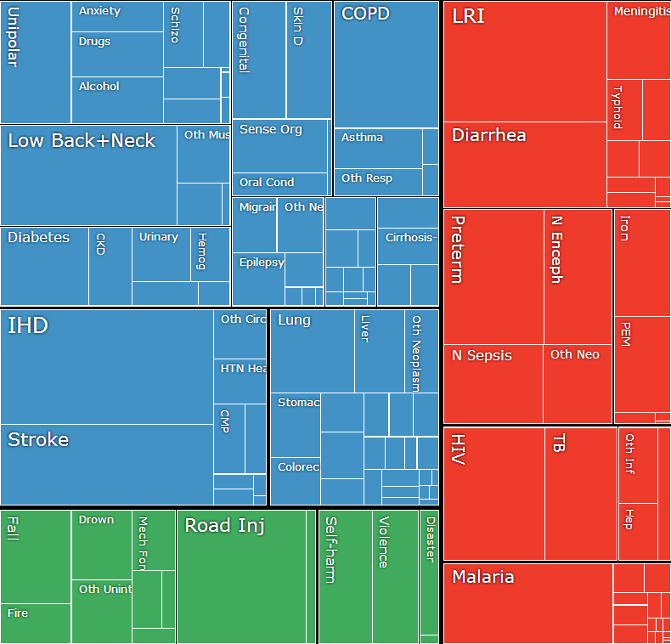
One DALY equals one lost year of healthy life
GBD-Compare
Notes:
I promise that this will all relate to the stated topic of this talk in a minute, but I can’t help myself, and I have to take a brief detour to show you the results of the GBD 2010 Study. I think that this will put our mortality study in context.

Slide 5
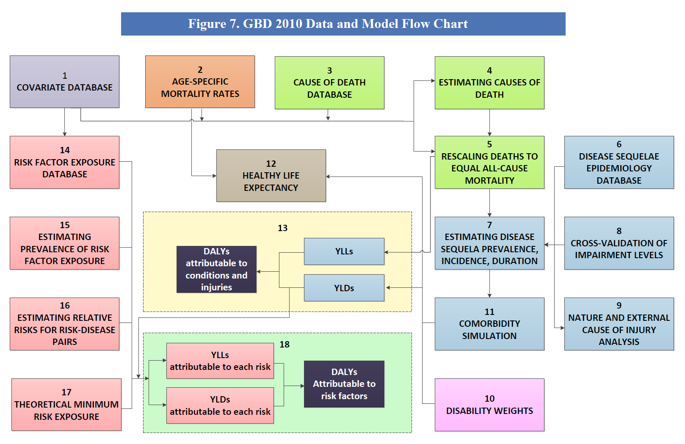

Slide 6
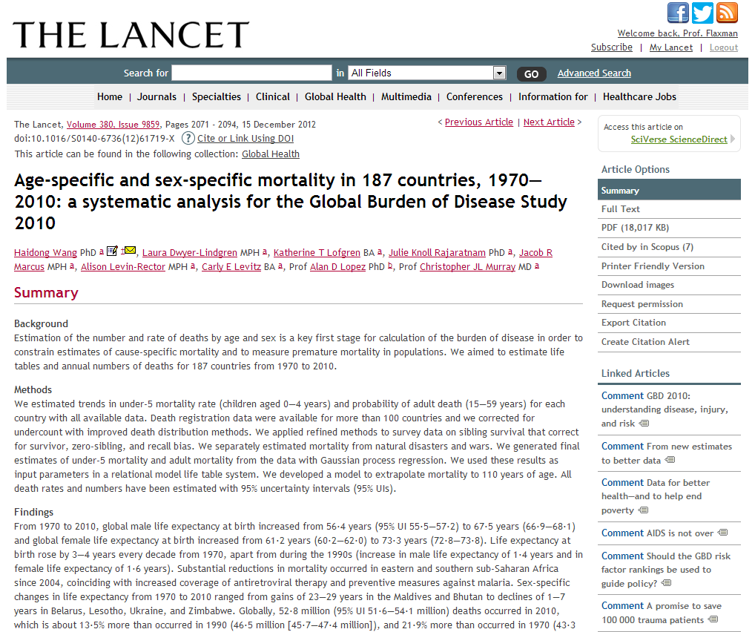
Notes:
One of the problems with global health metrics is that people care about them. Actually, that’s not a problem. The problem is that people care about them so much that they want the numbers to come out certain ways.
Sometimes they want numbers to be lower, to show that a project to improve population health is working.
Sometimes they want numbers to be higher, to show that a project to improve population health is needed.
There was a time when each advocacy group for fighting disease X would produce their own estimates of, say, the number of deaths due disease X, and use this number for fund raising purposes. Decentralization is good. But the problem with this decentralization is that the sum of deaths over all advocacy groups was 2 or 3 times the total number of deaths.
GBD 2010 addresses this by estimating the total number of deaths first, and then ensuring that the deaths due to the 200 diseases and injuries add up to the total.
The problem with this is that we need to know the total number of deaths.

Slide 7
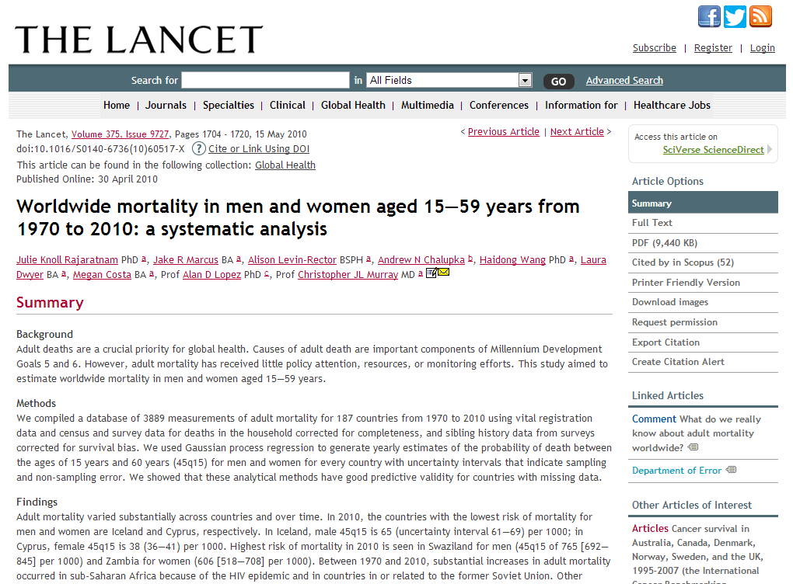
Notes:
One of the problems with global health metrics is that people care about them. Actually, that’s not a problem. The problem is that people care about them so much that they want the numbers to come out certain ways.
Sometimes they want numbers to be lower, to show that a project to improve population health is working.
Sometimes they want numbers to be higher, to show that a project to improve population health is needed.
There was a time when each advocacy group for fighting disease X would produce their own estimates of, say, the number of deaths due disease X, and use this number for fund raising purposes. Decentralization is good. But the problem with this decentralization is that the sum of deaths over all advocacy groups was 2 or 3 times the total number of deaths.
GBD 2010 addresses this by estimating the total number of deaths first, and then ensuring that the deaths due to the 200 diseases and injuries add up to the total.
The problem with this is that we need to know the total number of deaths.

Slide 8
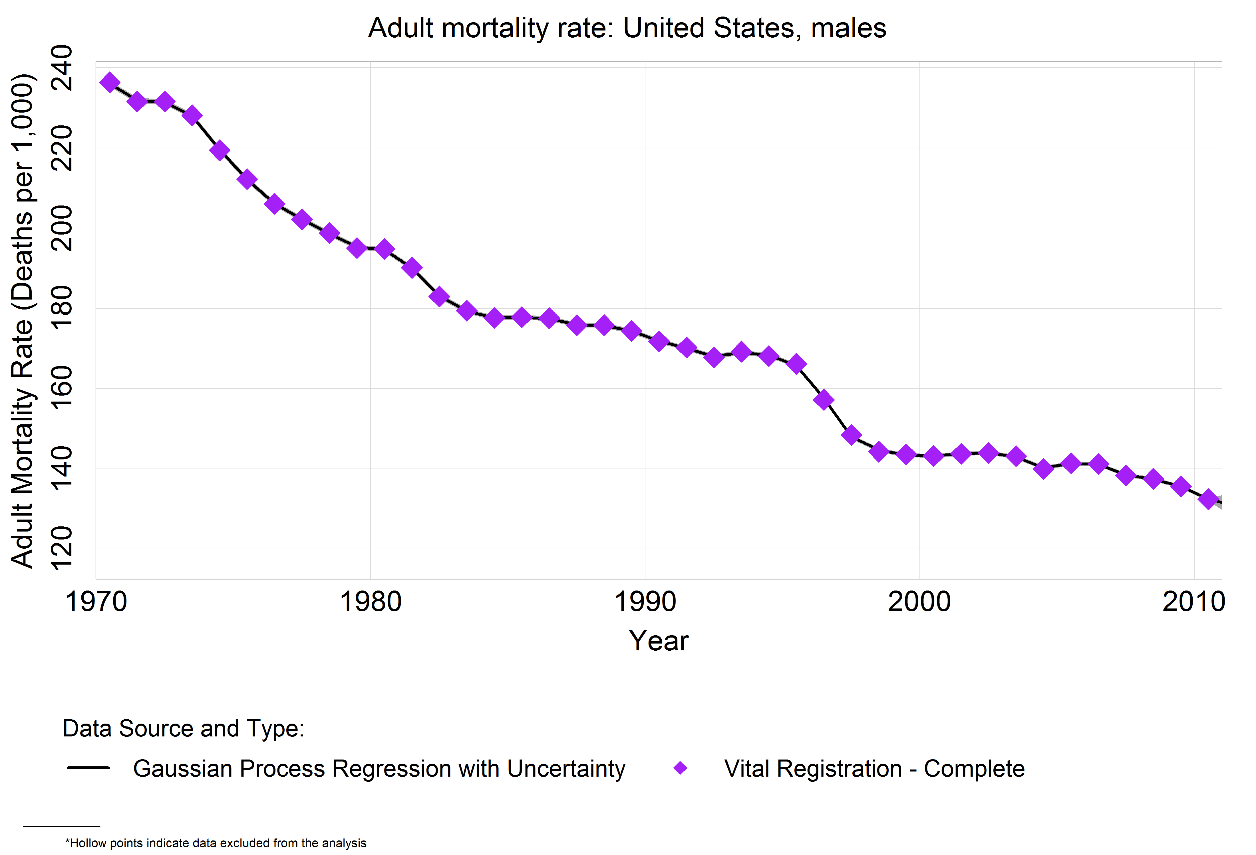
Notes:
This is a reasonable request in a place like the United States, where the Census Bureau and the CDC are keeping very careful track of how many people there are and how many pass away.

Slide 9
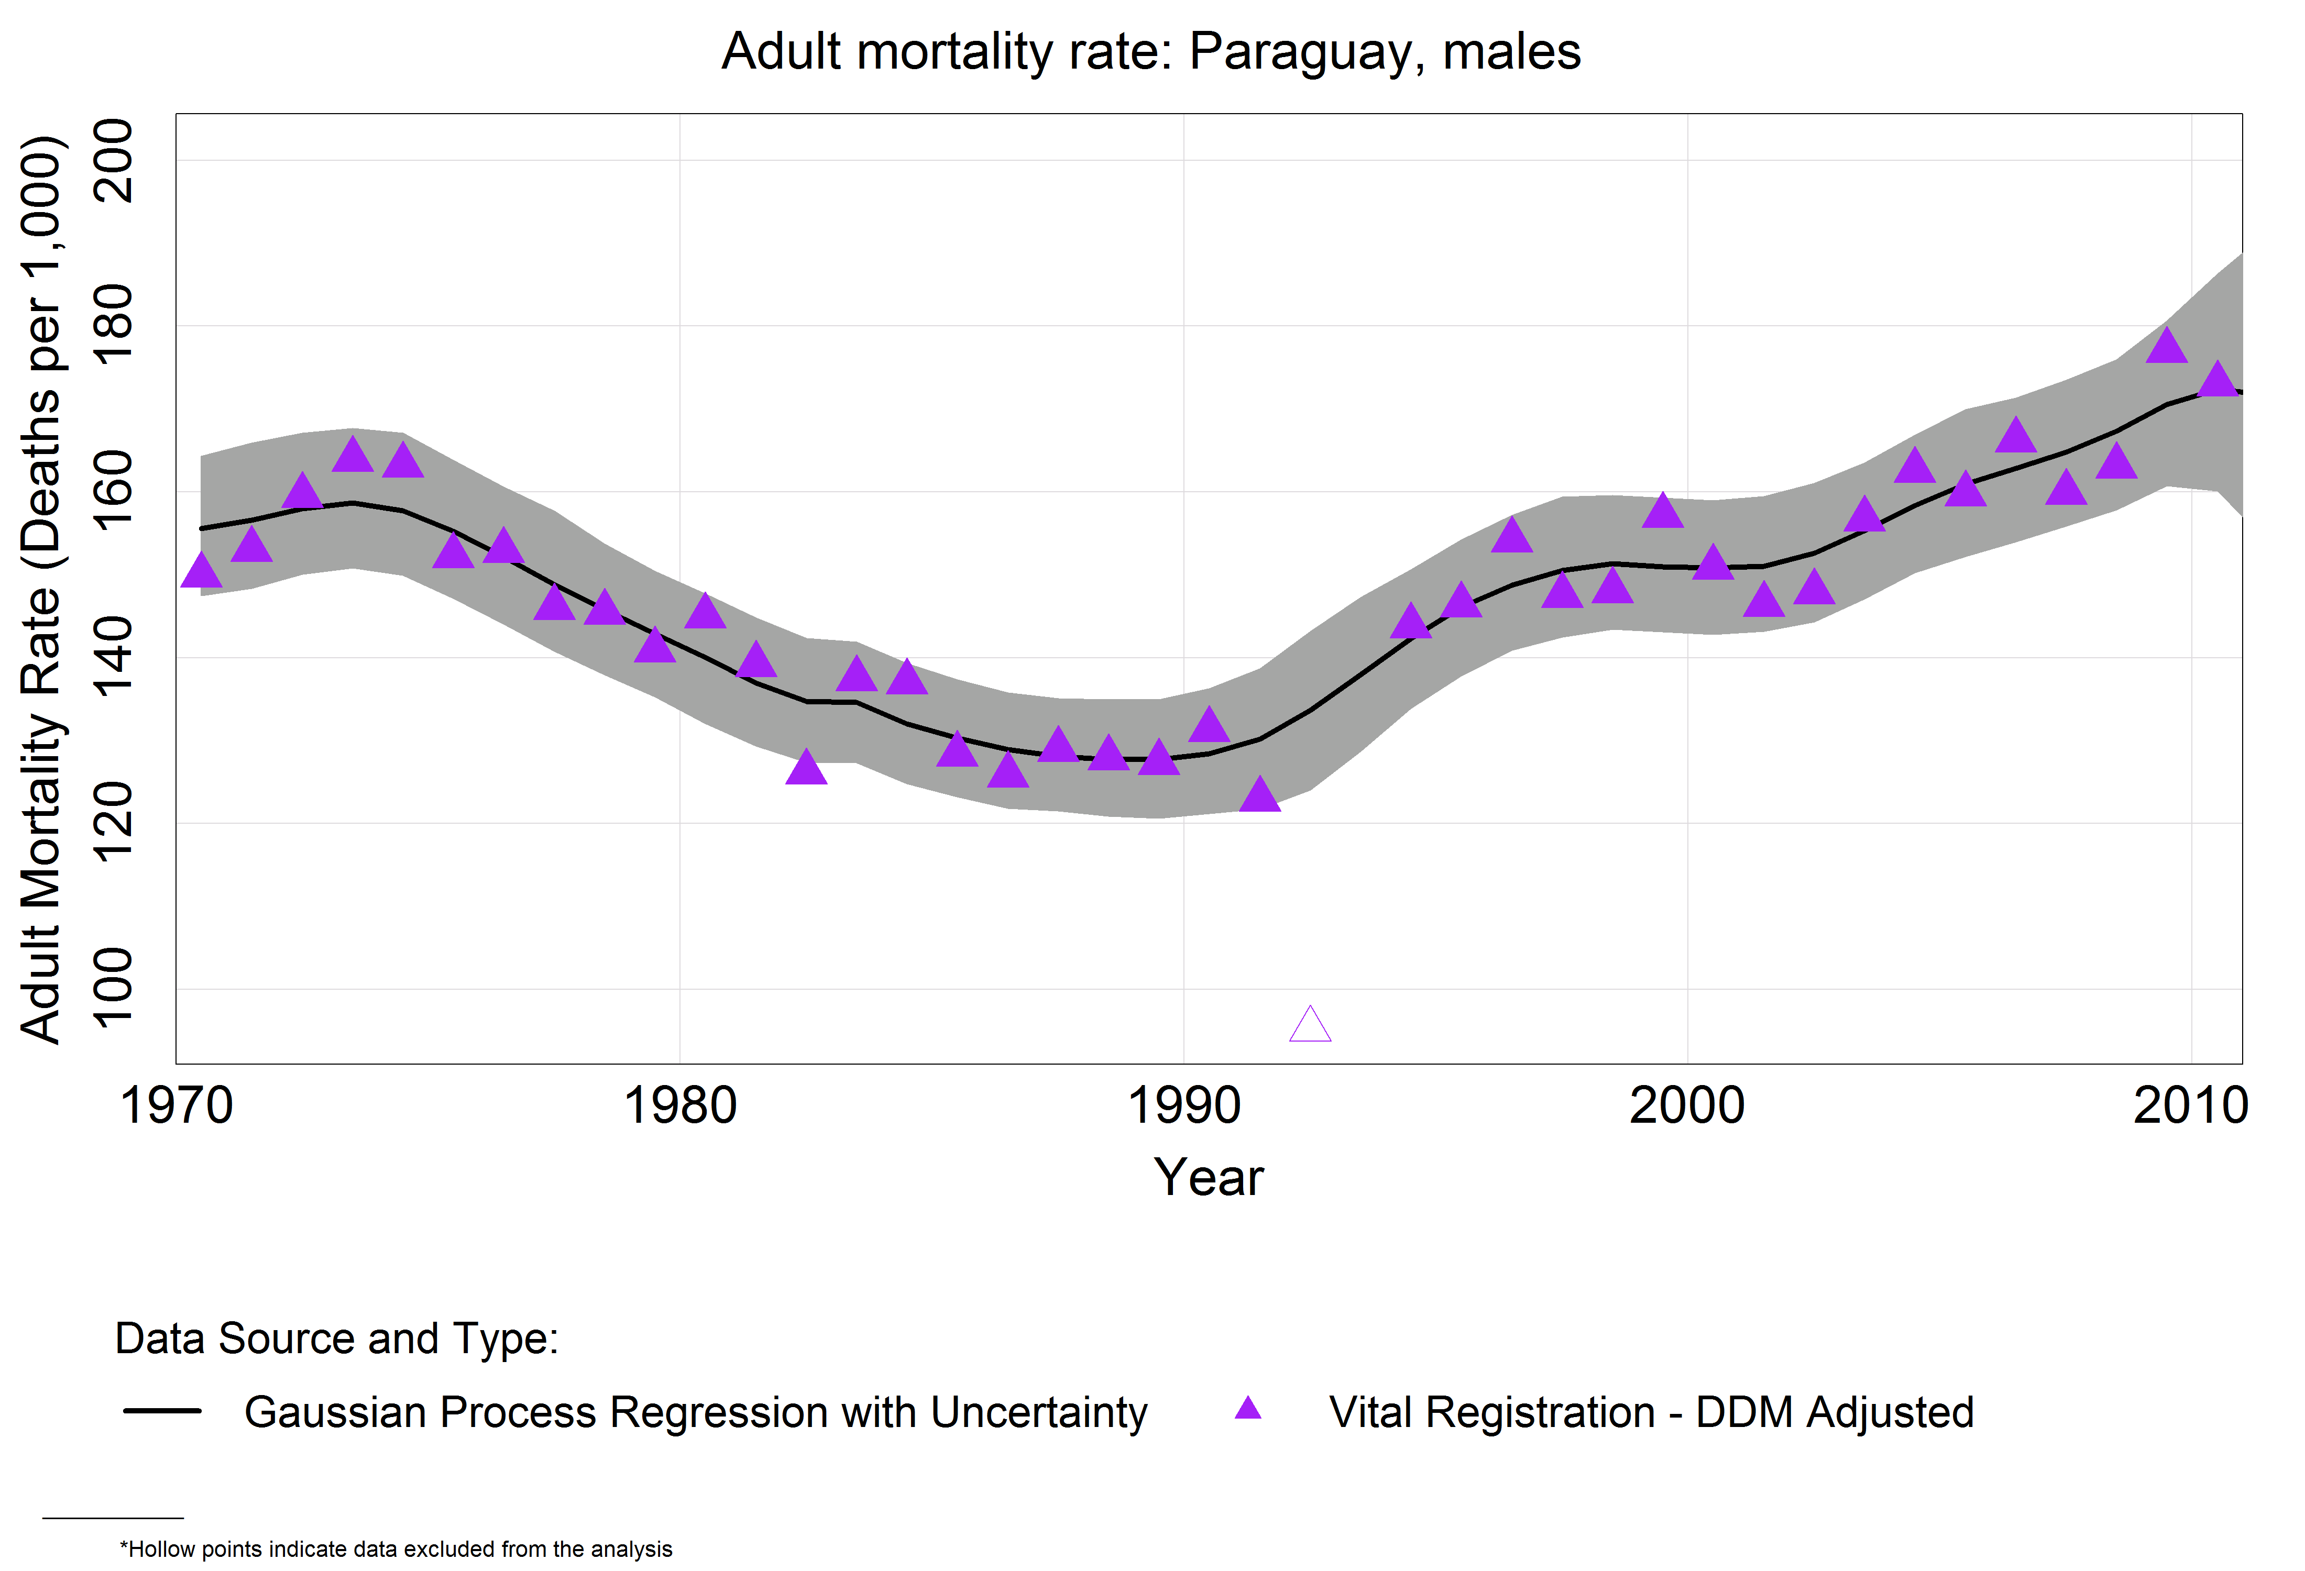
Notes:
And its reasonable in Paraguay, too.

Slide 10
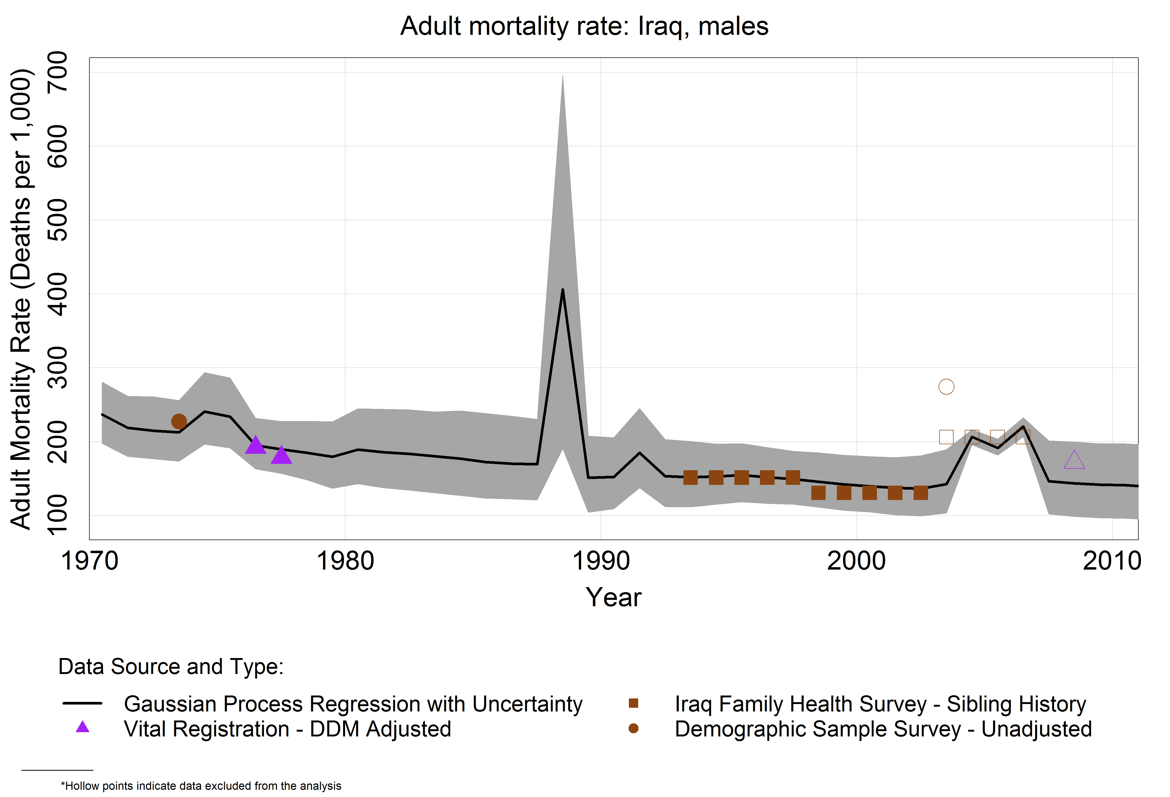
Notes:
But what about somewhere like Iraq? Where the data isn’t available.
This figure shows what we had to do for the GBD 2010 study: gather together all the available data, which is sometimes BIG, but sometimes just a sprinkling of measurements from different sources in different years, and try to fill in the gaps.
Here is an example that highlights the limitation to this modeling approach. Look at the right-hand side of this curve, where the datapoints end. We had to make estimates about the adult mortality rate of the people in Iraq in 2010 without any data to go on after 2006!
Models have some very interesting and intensive mathematical needs, but they cannot do magic. Eventually, someone needs to go and find out first hand.

Slide 11
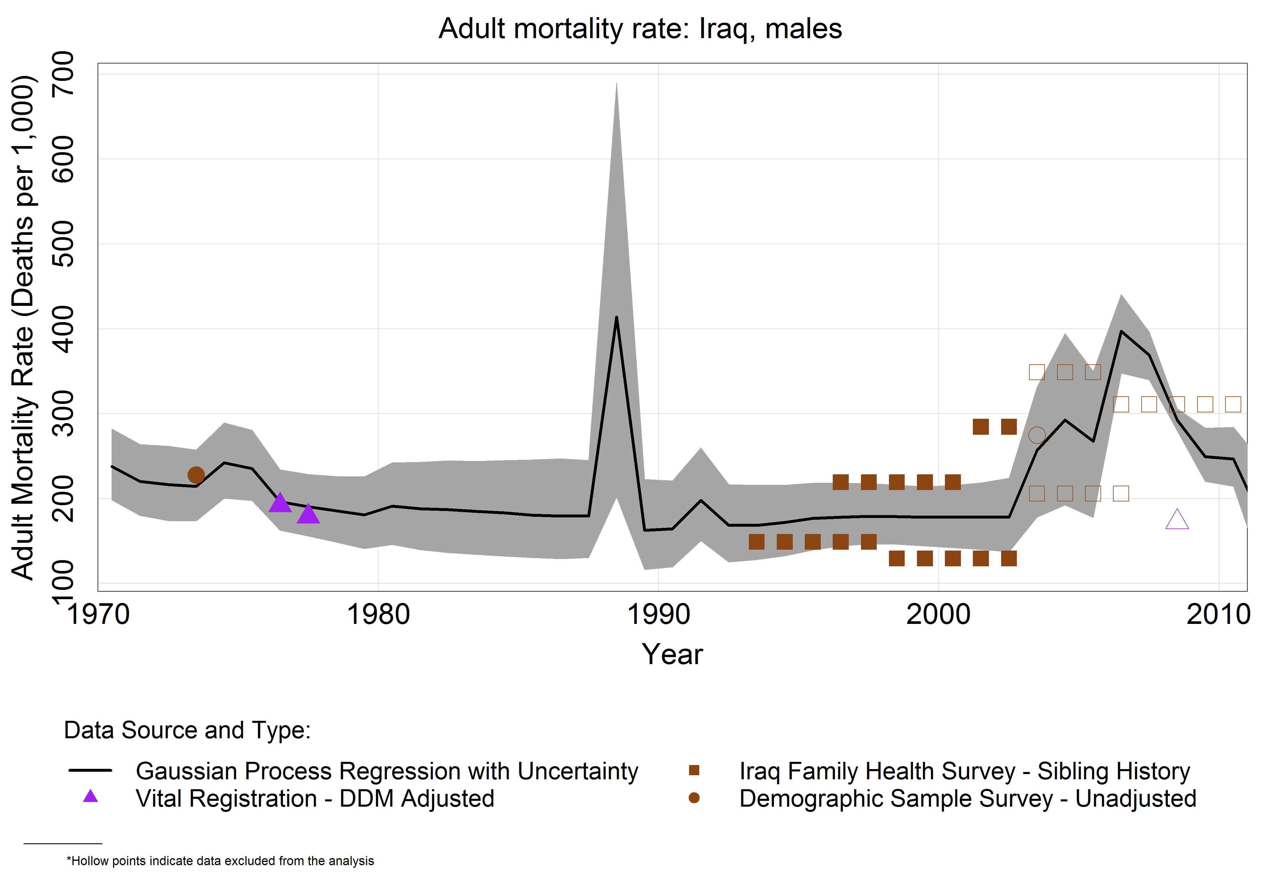

Slide 12
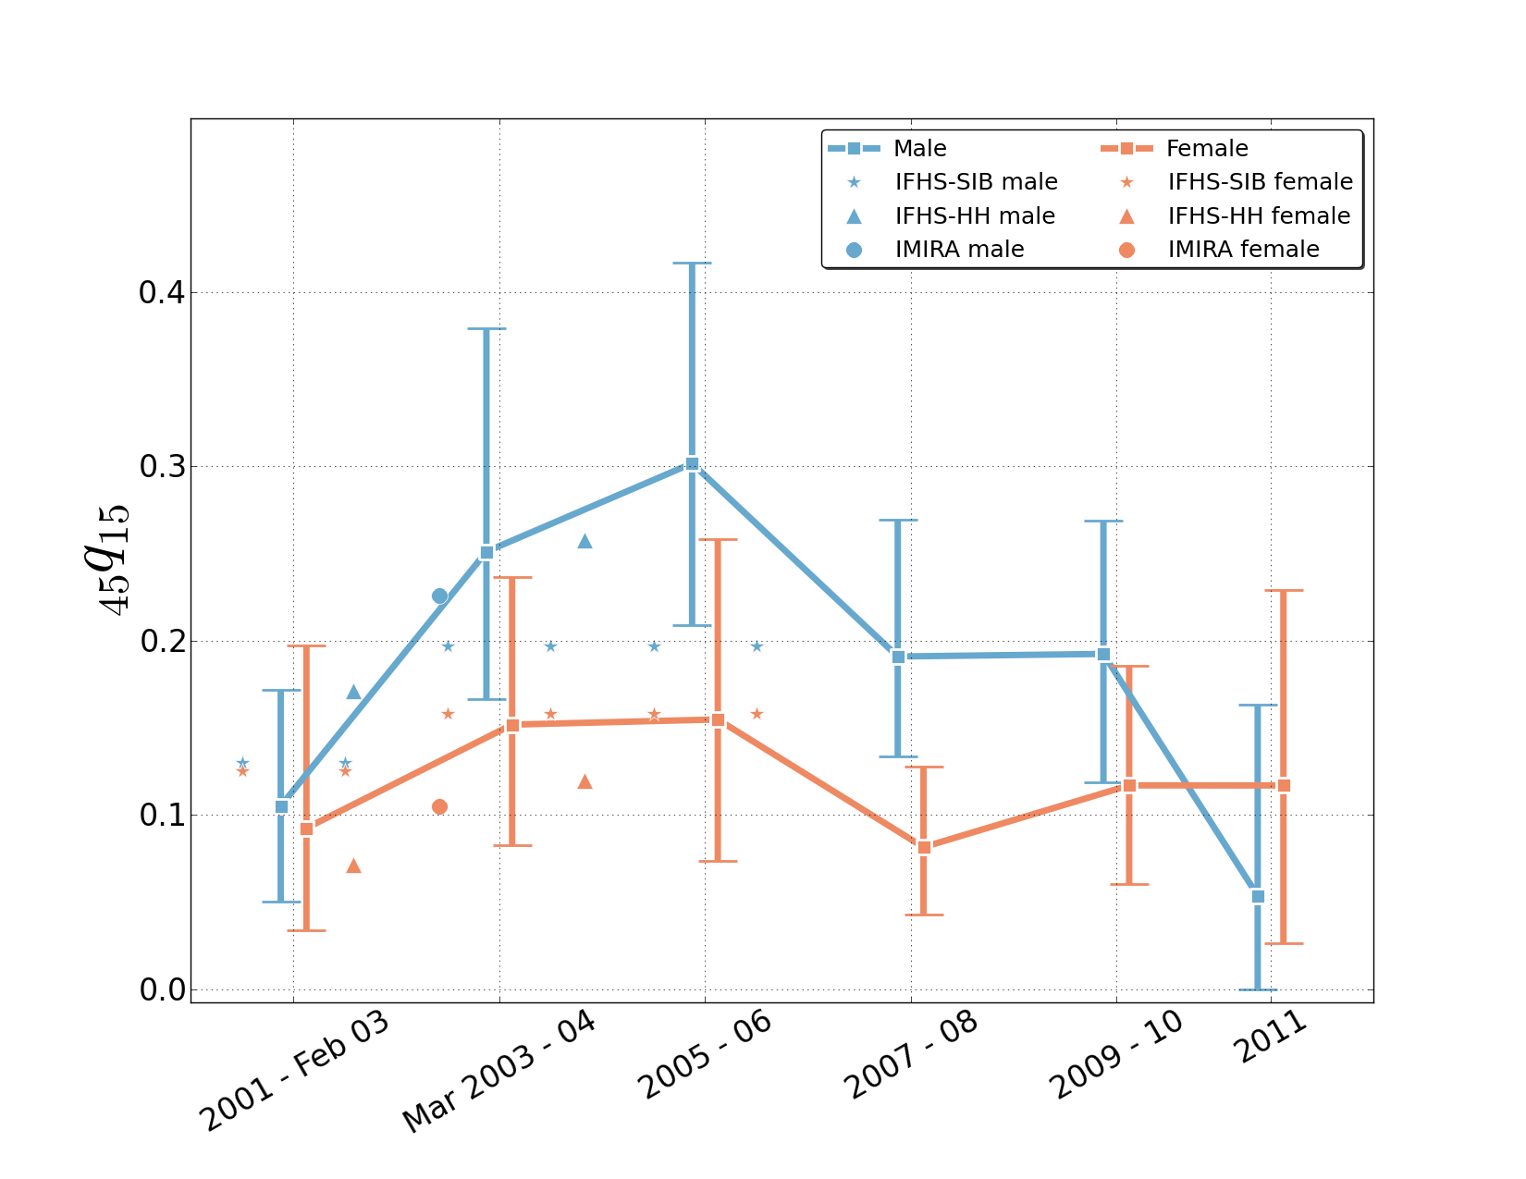
Iraq mortality study results

Slide 13

Filling this gap, the UCIMS
University Collaborative Iraq Mortality Study
Notes:
Of particular interest to me, because I left theoretical math to work in global health metrics research, drawn by the potential for my work to have relevance.

Slide 14
Outline
Introduction
Designing a controversial study
Results
Future directions

Slide 15
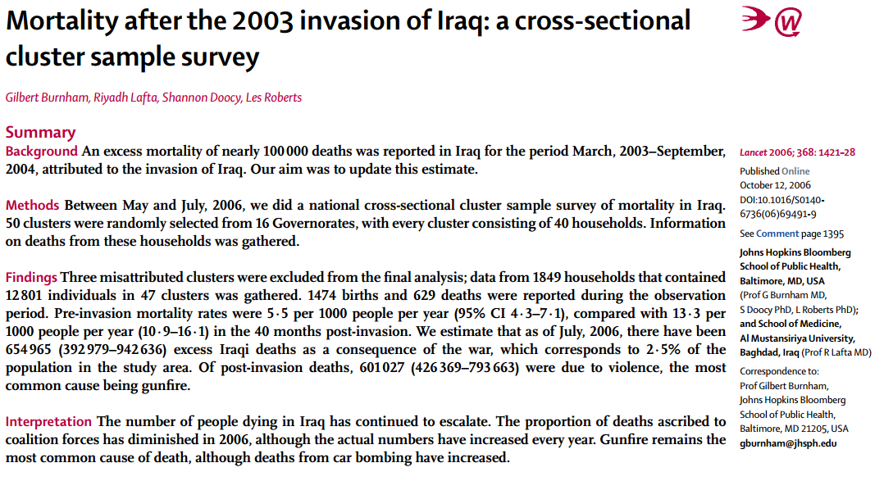
Relevance of Iraq Mortality studies
“No, I don’t consider it a credible report. Neither does General Casey and neither do Iraqi officials.”
George W. Bush, October 2006
Notes:
http://www.democracynow.org/2006/10/12/headlines
http://mediamatters.org/research/2006/10/12/abcs-gibson-falsely-reported-bush-said-too-many/136923

Slide 16
Approaches to measuring mortality in crisis
Vital registration
Passive surveillance, e.g. reports from media or participants
Survey (or census) post-conflict
Notes:
What is the point of this information?

Slide 17
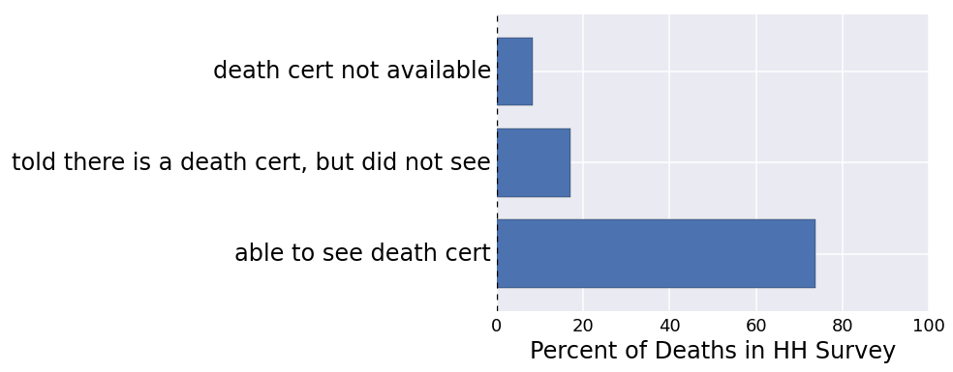
Approaches to measuring mortality in crisis
Vital registration
Passive surveillance, e.g. reports from media or participants
Survey (or census) post-conflict
Notes:
What is the point of this information?

Slide 18
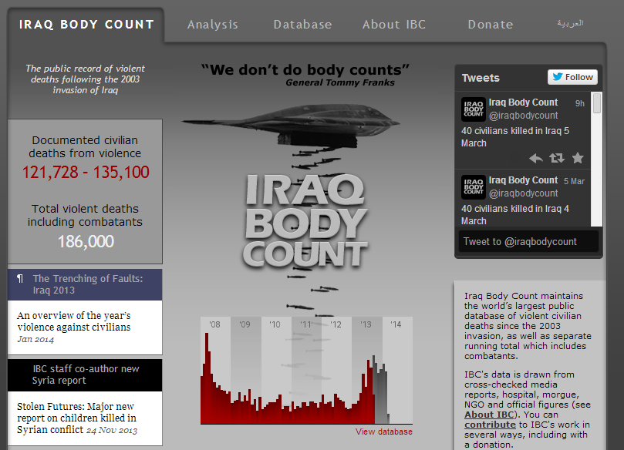
Approaches to measuring mortality in crisis
Vital registration
Passive surveillance, e.g. reports from media or participants
Survey (or census) post-conflict
Notes:
What is the point of this information?

Slide 19
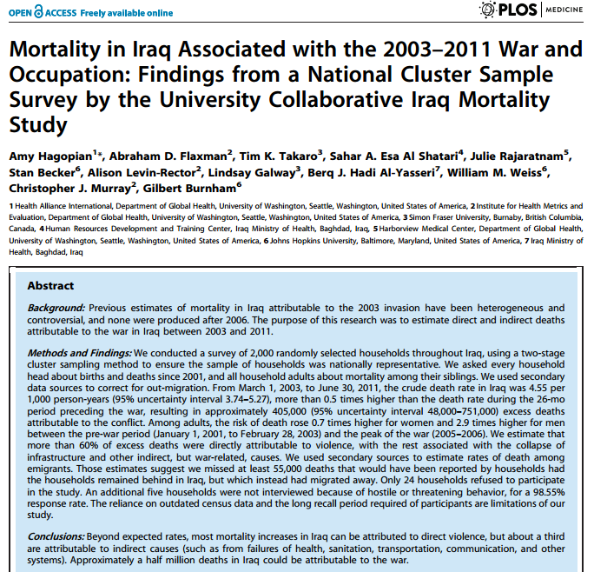
Approaches to measuring mortality in crisis
Vital registration
Passive surveillance, e.g. reports from media or participants
Survey (or census) post-conflict
Notes:
What is the point of this information?

Slide 20
Uses of this information
Treat: know health needs in crisis
Prevent: if we know the human cost of war, will we still fight?
Plan: understand the impact when we do fight in context of other conditions (i.e. improve upon GBD 2010 estimates)

Slide 21
Designing a controversial study
Based on past experience, expected criticism
Practice of defensive science:
Read, understand all past criticism
Identify major issues
Address them directly
Transparency of study operations
Main-street bias
Sample-size concerns

Slide 22
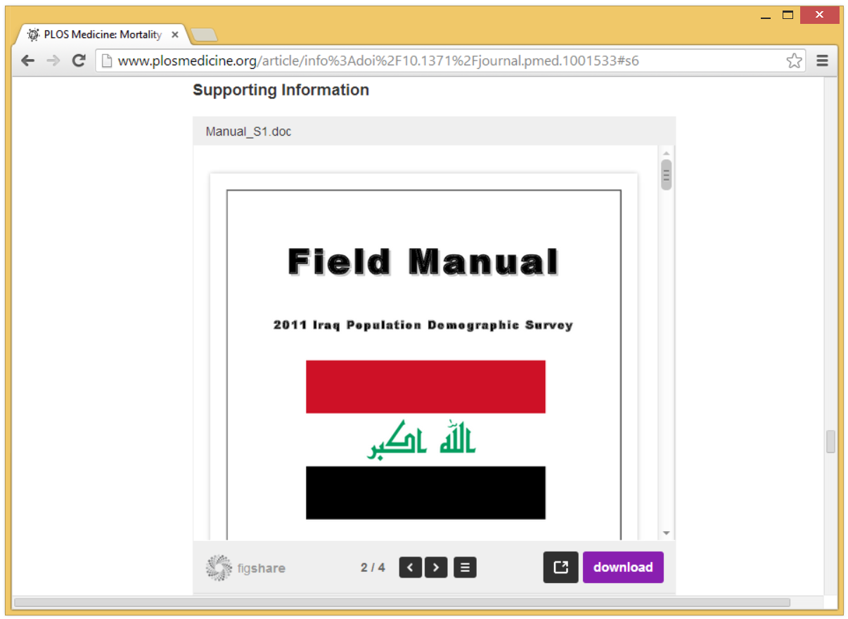
Transparency of Operations
Notes:
http://www.plosmedicine.org/article/info%3Adoi%2F10.1371%2Fjournal.pmed.1001533#s6

Slide 23
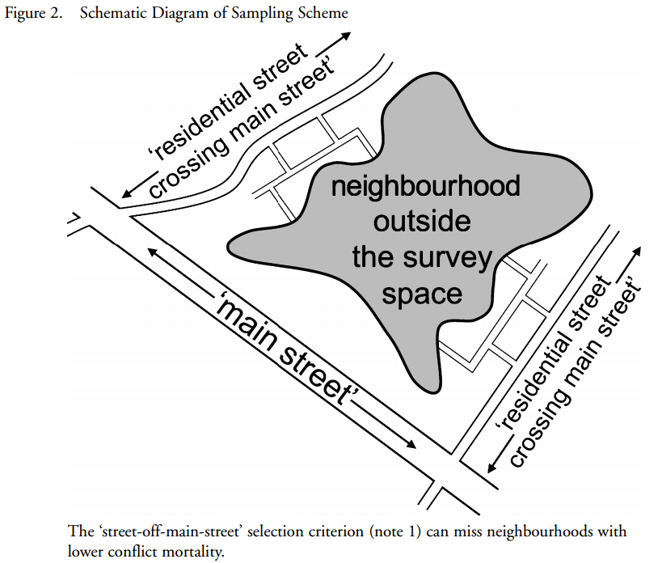
Main street bias
Notes:
From doi: 10.1177/0022343308094325Journal of Peace ResearchSeptember 2008 vol. 45 no. 5 653-663

Slide 24
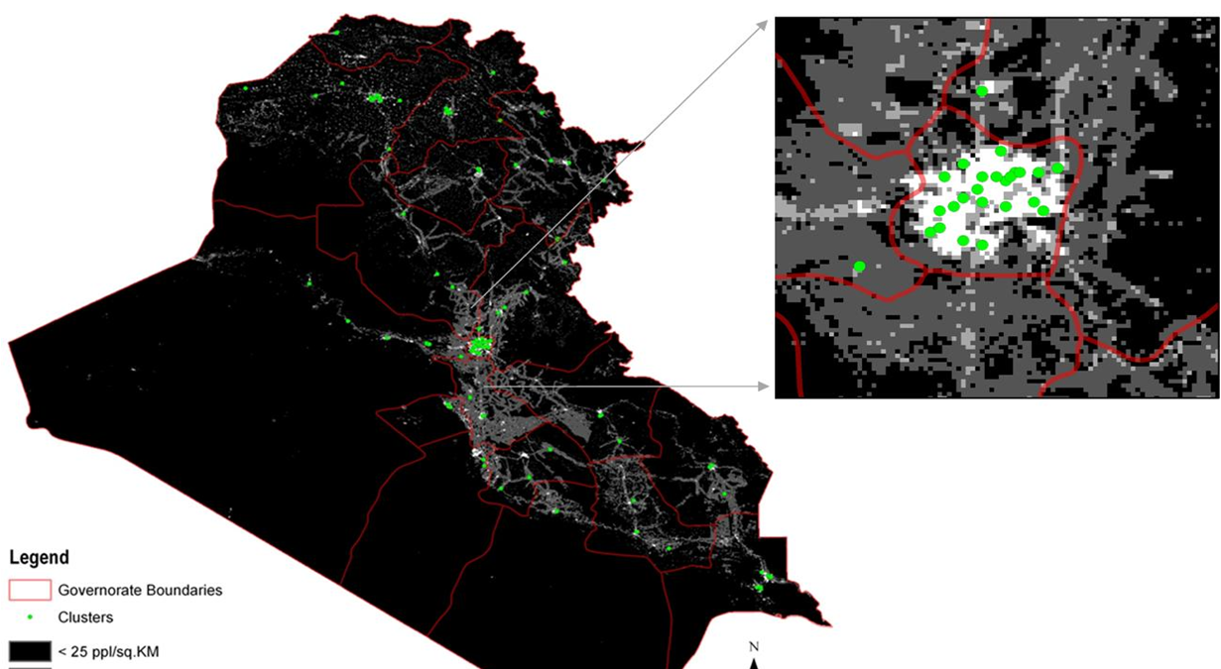
A 2-stage cluster sampling method using gridded population data, a GIS and Google Earth imagery
Galway et al, Int J of Health Geographics, 2012.
Notes:
We decided to select a random sample consisting of 100 clusters of 20 households each, for a total of 2000 households. The cluster selection method was quite innovative, and our process for that has already been published in a health geography journal. We used Google Earth maps loaded with population data, overlaid a grid with squares calibrated at 1 square kilometer, and randomly selected 100 of these across Iraq. In each of these clusters, we overlaid another grid, and randomly chose a start house. Surveyors were instructed to choose the 19 closest houses to the start house, with some elaborate rules about the direction to walk in.

Slide 25
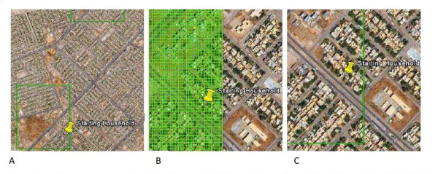
Selecting “start households”
Notes:
Image A. represents an illustrative cluster outlined in green. Image B shows the sampling grid laid over it. Image C shows dropping a pin on a starting household. The image of the sampling grid shows only a small proportion of the entire grid. The imagery is from Google EarthTM.

Slide 26
Notes:
Here we illustrate Wikileaks data to show the most dangers parts of Baghdad. Our clusters are in square, so you can see we hit some dangerous areas, and some more peaceful ones. The oblong circles represent the clusters chosen in the previous Burnham study published in 2006.

Slide 27
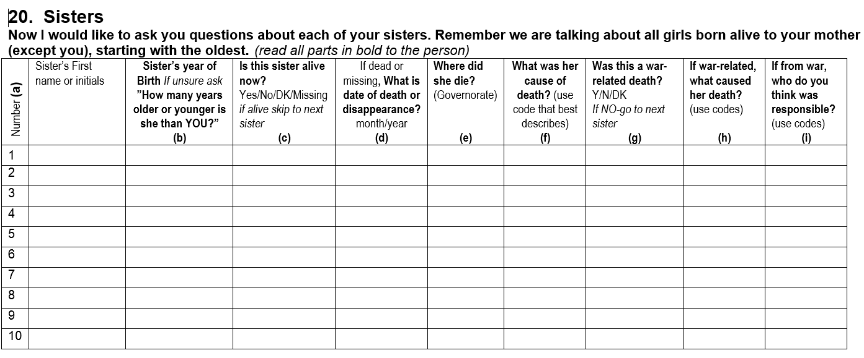
Sibling history methods (increase study size on a budget)

Slide 28
Deaths Reported in Households
Notes:
Our household survey, administered to 2000 households, identified 6400 people living in those dwellings at the start of the study period (2001) and close to 10,500 household members at the end of the 10-year period. We generated crude death rates, which, when multiplied to the whole population, generated a total death count of 1.3 million, about 405,000 attributable to the war either directly or indirectly. We knew we were undercounting deaths because households with deaths were more likely to have migrated away from Iraq.

Slide 29
Deaths Reported among Siblings
Notes:
Our sibling questionnaire was administered to every adult member of the household, a total of about 4300 people, who reported on the alive or dead status of their 25,000 siblings. From this, we can calculate the probably of dying before age 60 for those who have reached the age of 15. When applied to the total population, we count 381,000 adult deaths during the period of the war, about half of which were war-related.

Slide 30
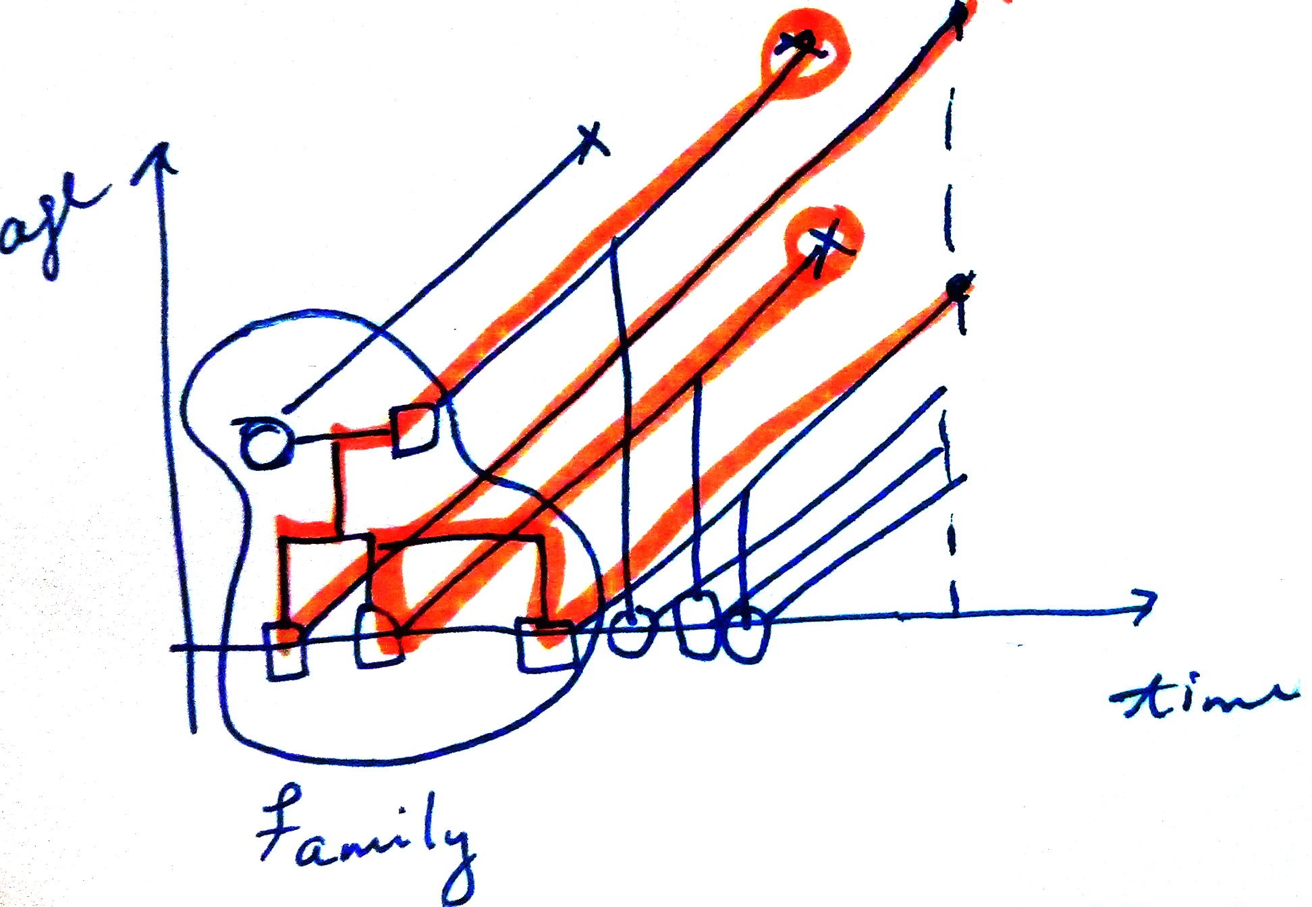
Sibling history methods (increase study size on a budget)

Slide 31
Additional technical considerations
Novel approach to real-time quality assurance
Correcting for migration bias

Slide 32
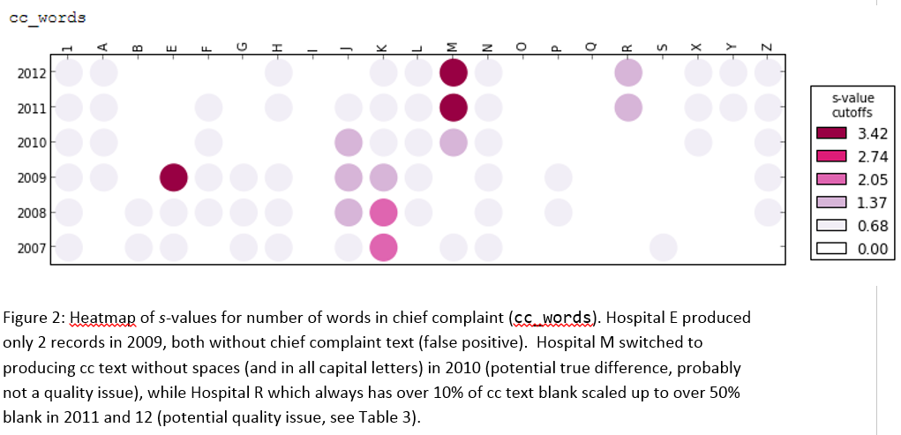
Additional technical considerations
Novel approach to real-time quality assurance (D3QA)
Correcting for migration bias

Slide 33
Additional technical considerations
Novel approach to real-time quality assurance
Correcting for migration bias
(2 million migrants) / (5.34 residents per household)
= 374,532 migrant households
No. migrant households x 14.9% HH experiencing deaths
= 55,805 conflict-related deaths among migrants

Slide 34
Outline
Introduction
Designing a controversial study
Results
Future directions

Slide 35
Results
From March 2003 to June 2011, there were:
405,000 (95% UI 48,000-751,000) excess deaths due directly or indirectly to the conflict;
250,000 (95% UI 120,000-350,000) war-related injury deaths;
55,000 deaths in households that migrated out of Iraq

Slide 36
Results from sibling module corroborate
From March 2003 to June 2011, there were:
376,000 (95% UI 308,000–441,000) adult deaths due to any cause;
187,000 (95% UI 64,000–288,000) excess adult deaths due directly or indirectly to the conflict;
132,000 (95% UI 89,000–174,000) war-related injury deaths among adults.

Slide 37
Implications and future work
50% of adult deaths were due directly or indirectly to war
Of those:
70% were caused directly, by war-related injuries;
30% were caused indirectly by the conflict.

Slide 38
Outline
Introduction
Designing a controversial study
Results
Future directions

Slide 39
92% reported having death certificate, so potential for more information in future.

Slide 41
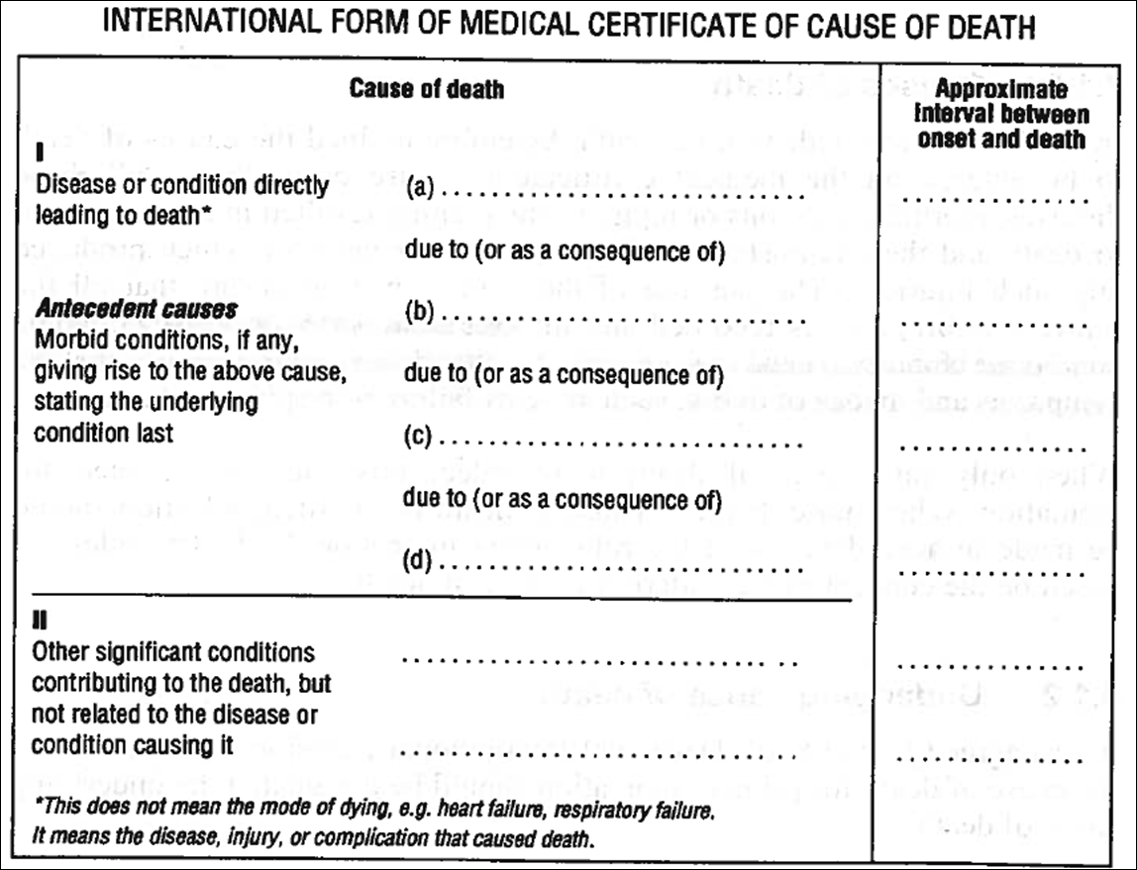
Pulmonary embolism | hours
Pathological fracture of Femur | 2 days
Secondary malignant neoplasm (femur) | 2 months
Malignant neoplasm of breast (nipple) | 1 year
Essential hypertension | 5 years
Obesity | 10 years
Notes:
Compelled to include this whenever there may be clinicians in the audience… death certificates, we use them.

Slide 42
Acute myocardial infarction | 1 hour
Essential Hypertension | 1 year
Diabetes mellitus 2 | 14 years
Hypothyroidism | 24 hours
Notes:
So please fill them out as accurately as you can!

Slide 43
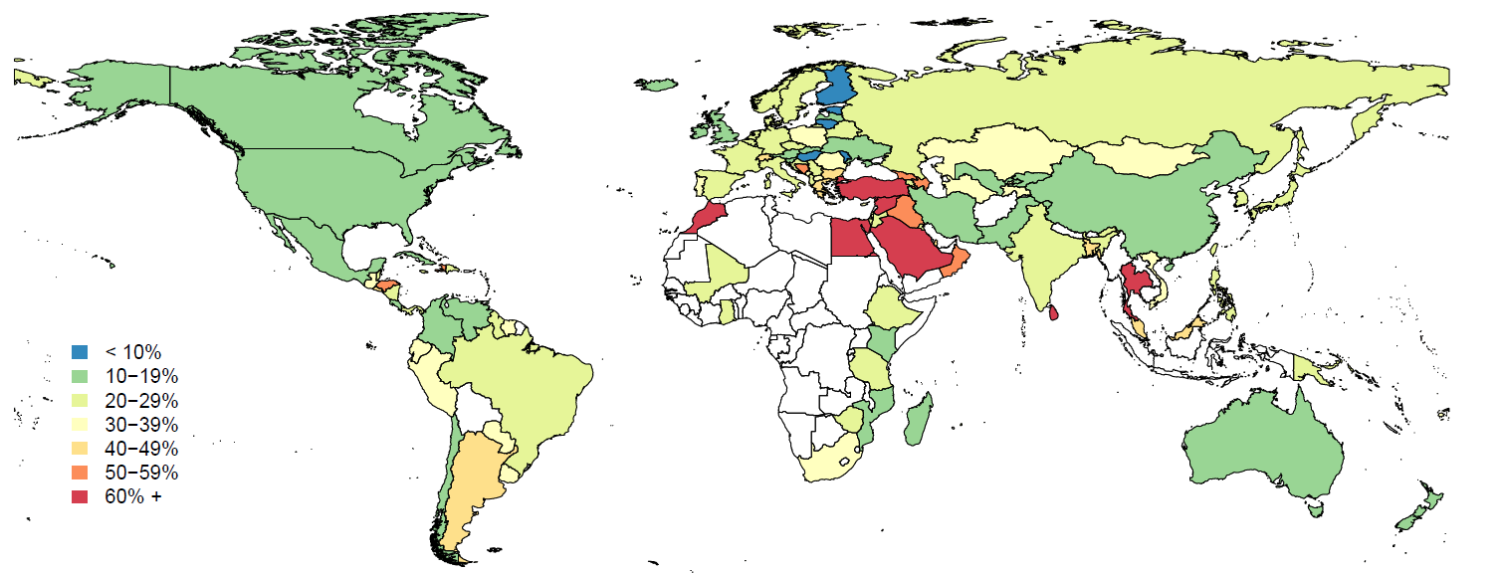
Percent of “Garbage” Death Certificates
Notes:
To count YLLs, you must know who is dying of what where. Since the early days of the World Health Organization, exactly this information has been reported country-by-country to the WHO.
But have a look at this map: the blue and green countries are the ones where the reported data has at least 80% of death certificates with valid causes of death recorded. The orange and red countries have more than half of their death certificates with an underlying cause-of-death that cannot be used for burden estimation. And the countries which are not colored in? They have no death certificate data at all.

Slide 44
Interventions to shore up health systems during crisis.

Slide 45
Beyond measuring mortality: non-fatal health outcomes in conflict.

Slide 46
Outline
Introduction
Designing a controversial study
Results
Future directions

Slide 47
Thank you. Questions?

